Slide 1
DoktorConnect Webpage Issue Report
Identifying and Addressing Bugs and Feature Enhancements

Slide 2
Overview of Identified Issues
This report highlights the current bugs and features that need fixing on the DoktorConnect landing webpage to improve functionality and user experience.

Slide 3
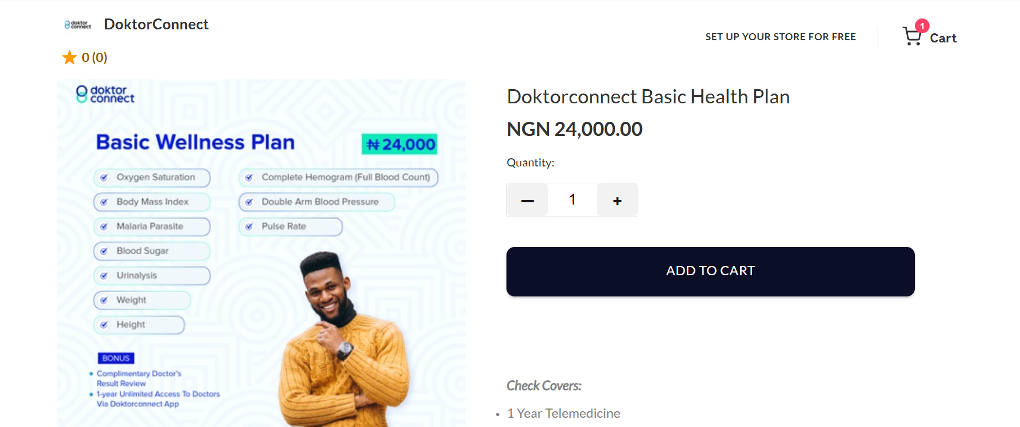
Change All Plan Images Containing Old Prices
Replace outdated images on the landing page.

Slide 4
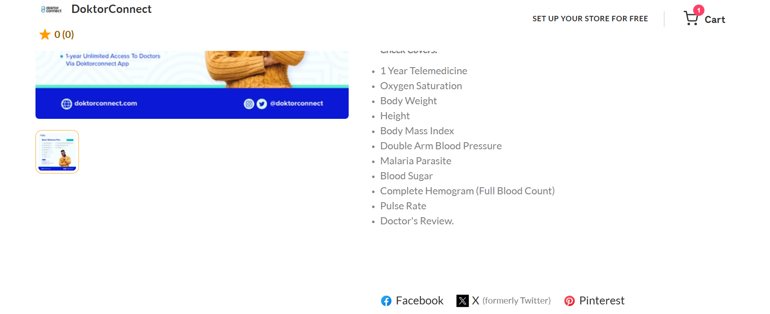
Flutterwave Communication
Coordinate with Flutterwave to update images, prices, and remove broken social media links.

Slide 5
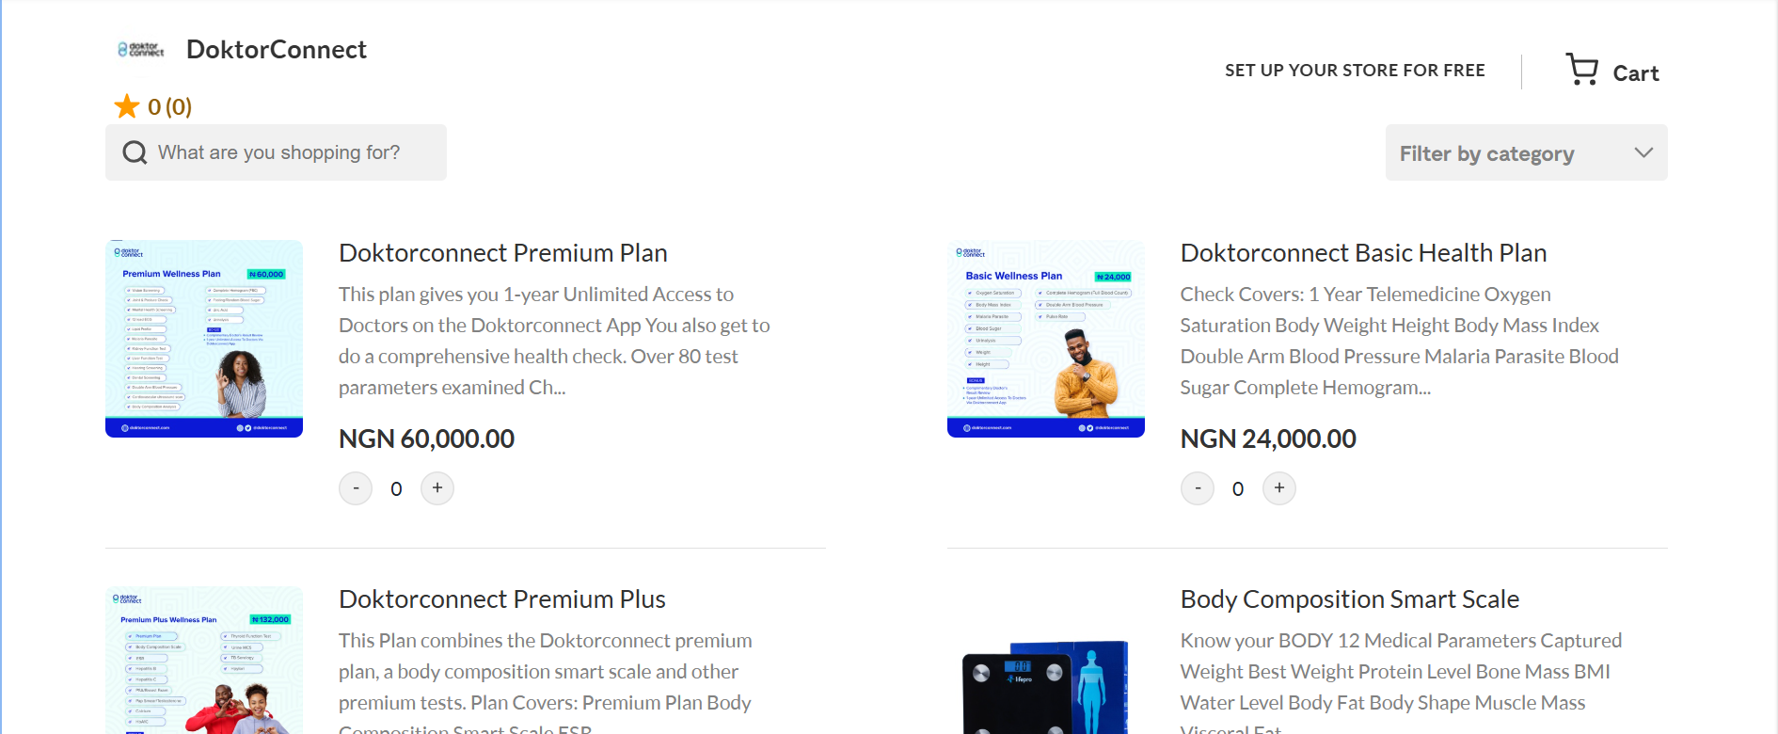
Review Page Price Images
Replace outdated price-related images on the review page.

Slide 6
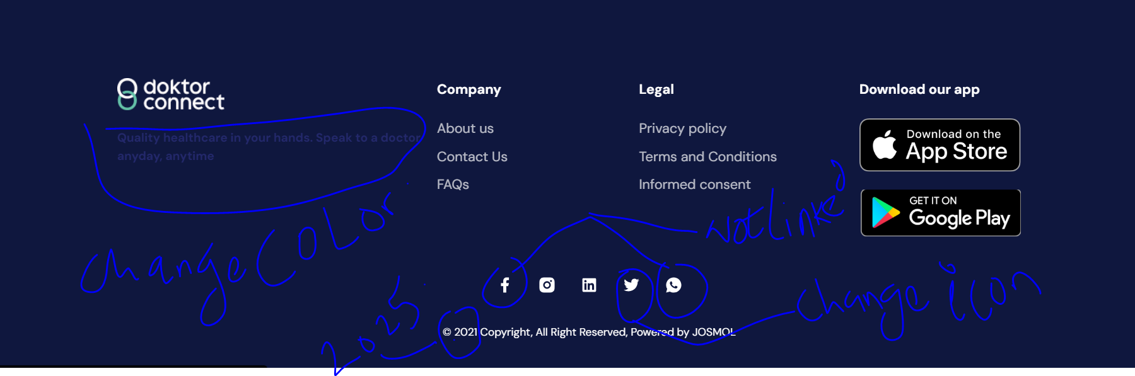
Change Twitter Icons to X
Replace all Twitter icons with updated 'X' branding.

Slide 7
WhatsApp and Facebook Links Broken
Fix non-functioning WhatsApp and Facebook links on webpage and footer.

Slide 8
Update Footer Copyright
Change '@ 2021 Copyright' to '@ 2025 Copyright'.

Slide 9
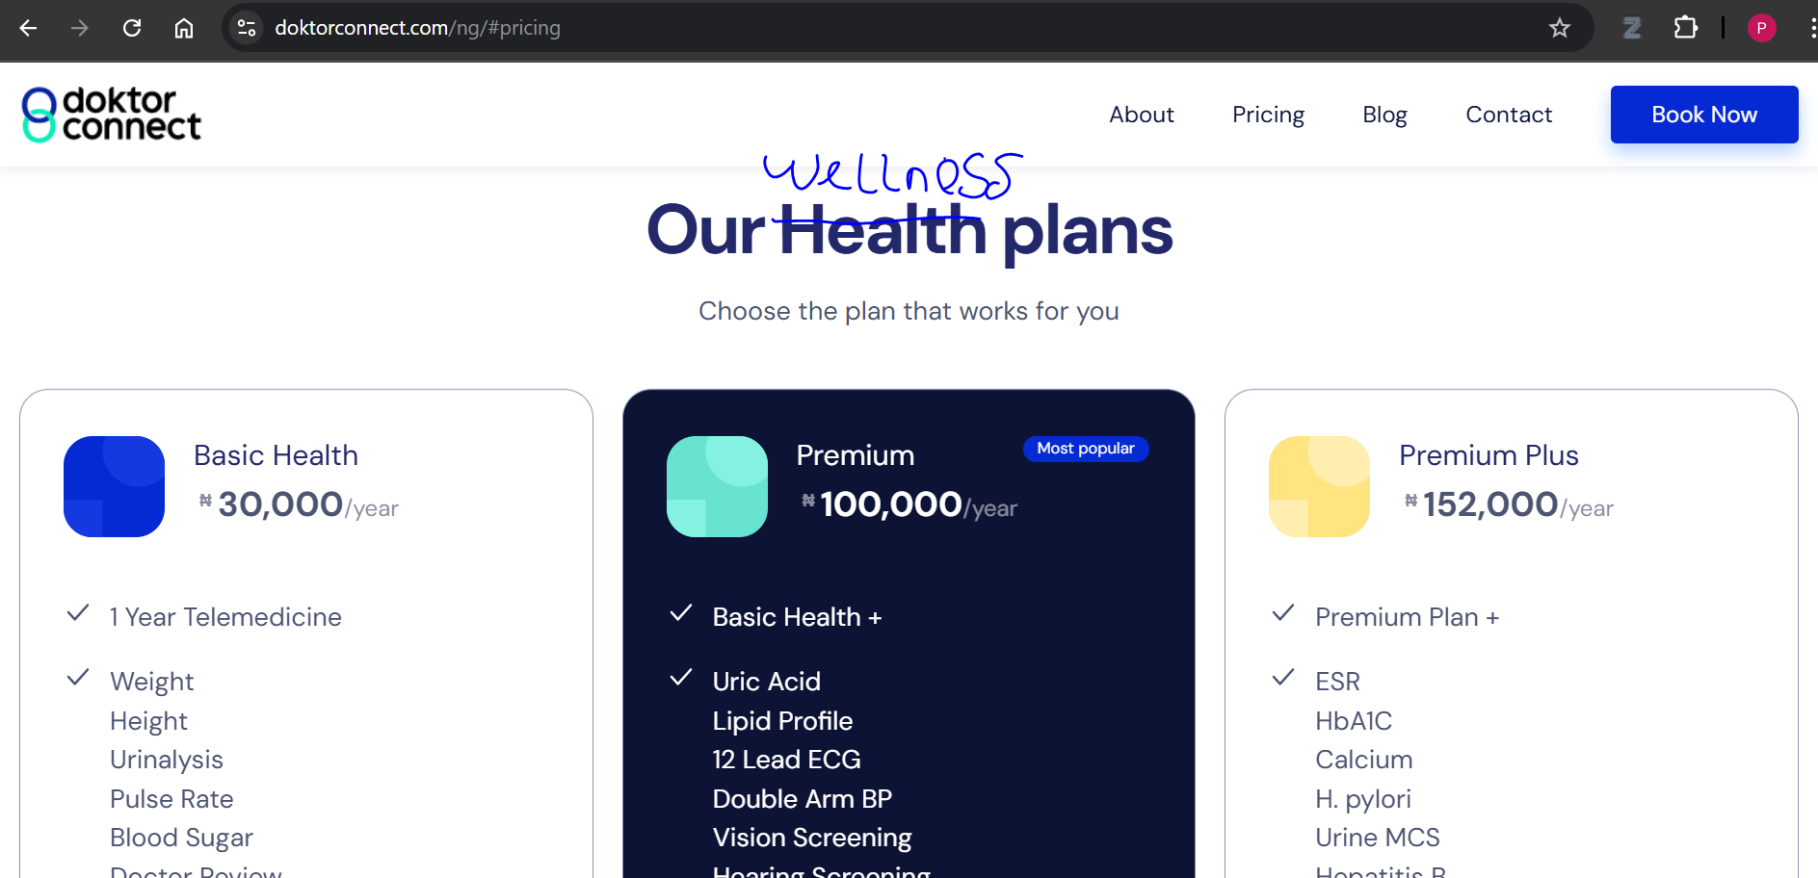
Rename Health Plans Header
Change 'Health Plans' header to 'Wellness Plans'.

Slide 10
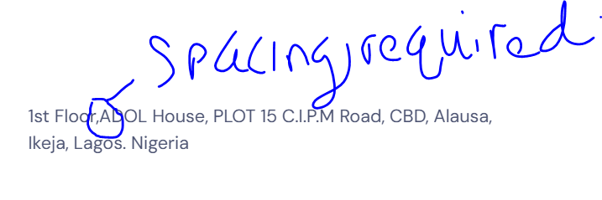
Address Spacing Issue
Add spacing in the address section for better readability.

Slide 11
Fix Footer Text Color
Adjust footer text color to enhance visibility.

Slide 12
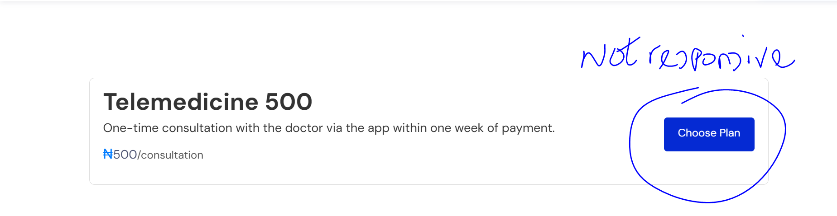
Telemedicine 500 Plan Responsiveness Issue
Ensure the plan is responsive across all devices.

Slide 13
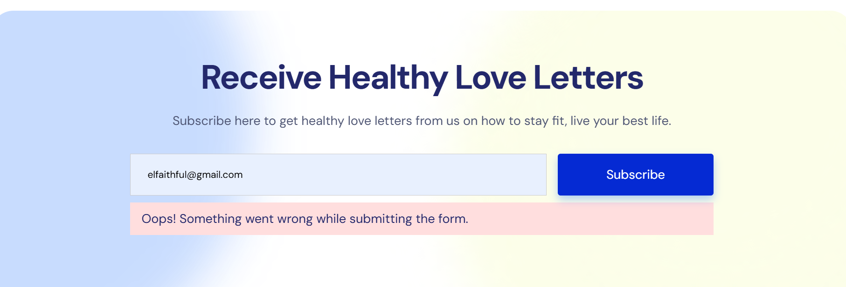
Newsletter Subscription Error
Resolve error messages preventing users from subscribing.

Slide 14
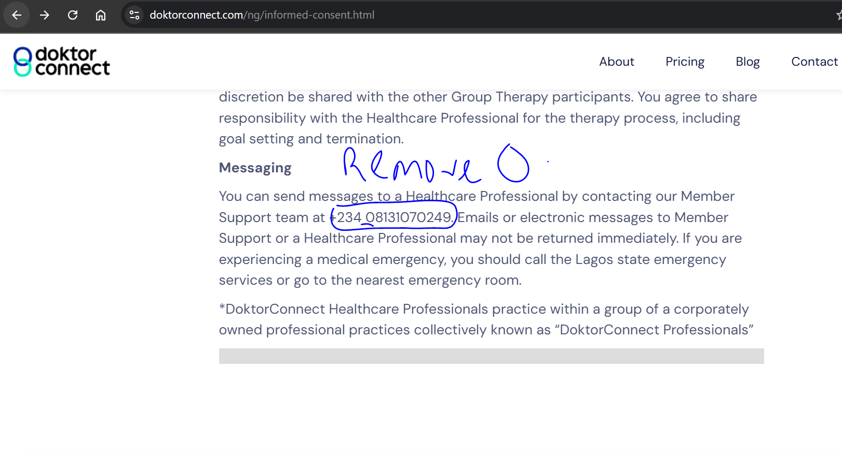
Informed Consent Page Phone Number
Update the phone number to the correct one.

Slide 15
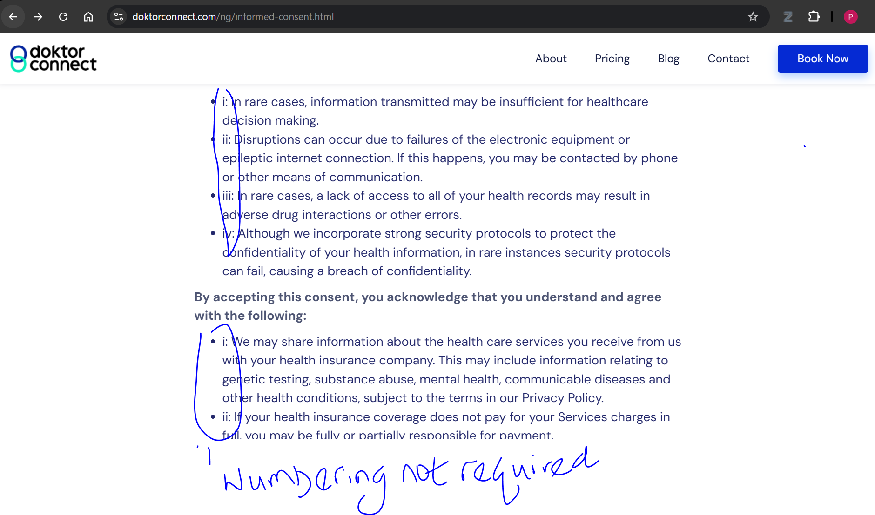
Policy Pages Formatting
Remove numbered formatting; use bullets for better readability.

Slide 16
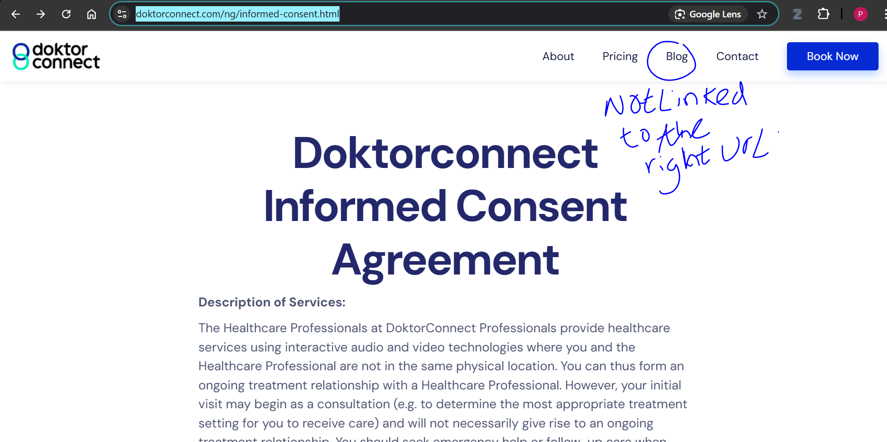
Blog Links Broken
Fix broken blog links in Privacy Policy, T&C, and Informed Consent pages.

Slide 17
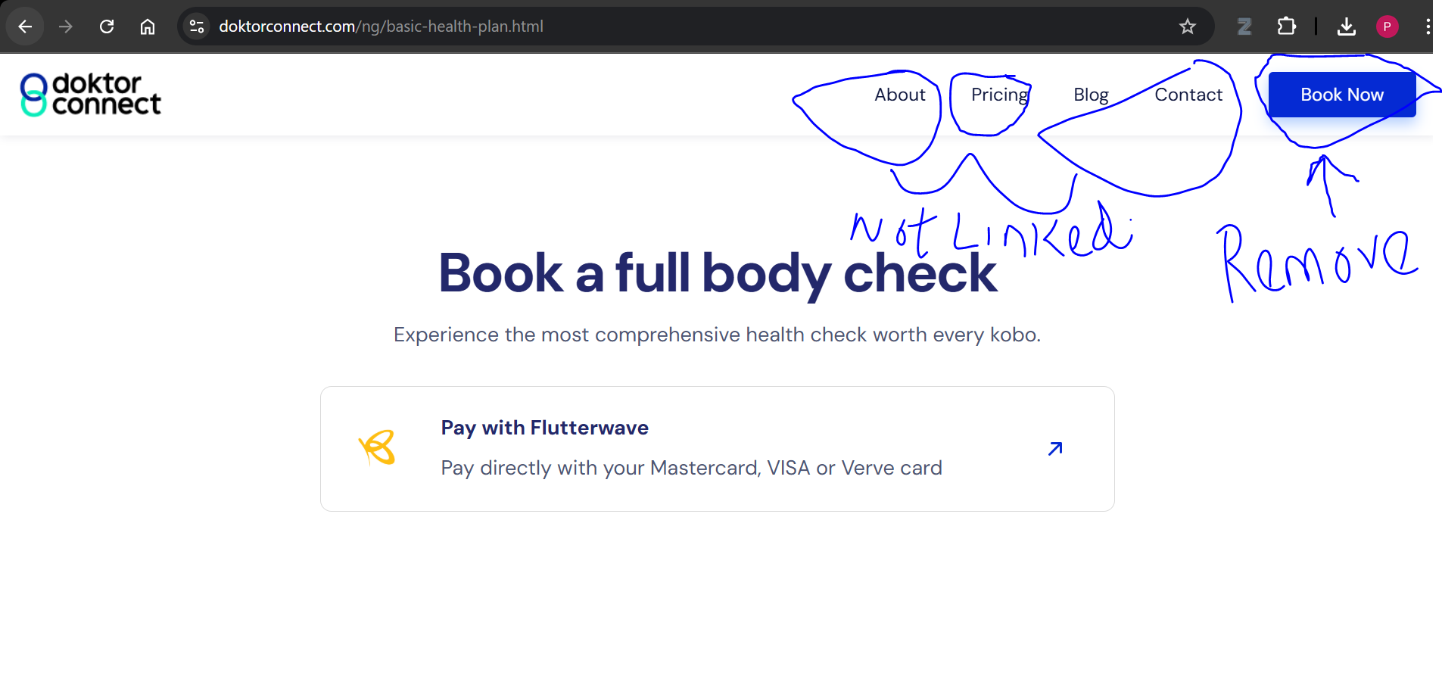
Navigation Links Issue in Plan Selection
Fix unresponsive 'About Us', 'Pricing', and 'Contact' links.

Slide 18
Remove 'Book Now' Option
Remove the 'Book Now' option from the main landing page.

